Slide 1
1. Connect
2. Git
3. Docker
4. Kubernetes
5. CI/CD
6. Misc

Slide 2


Slide 3
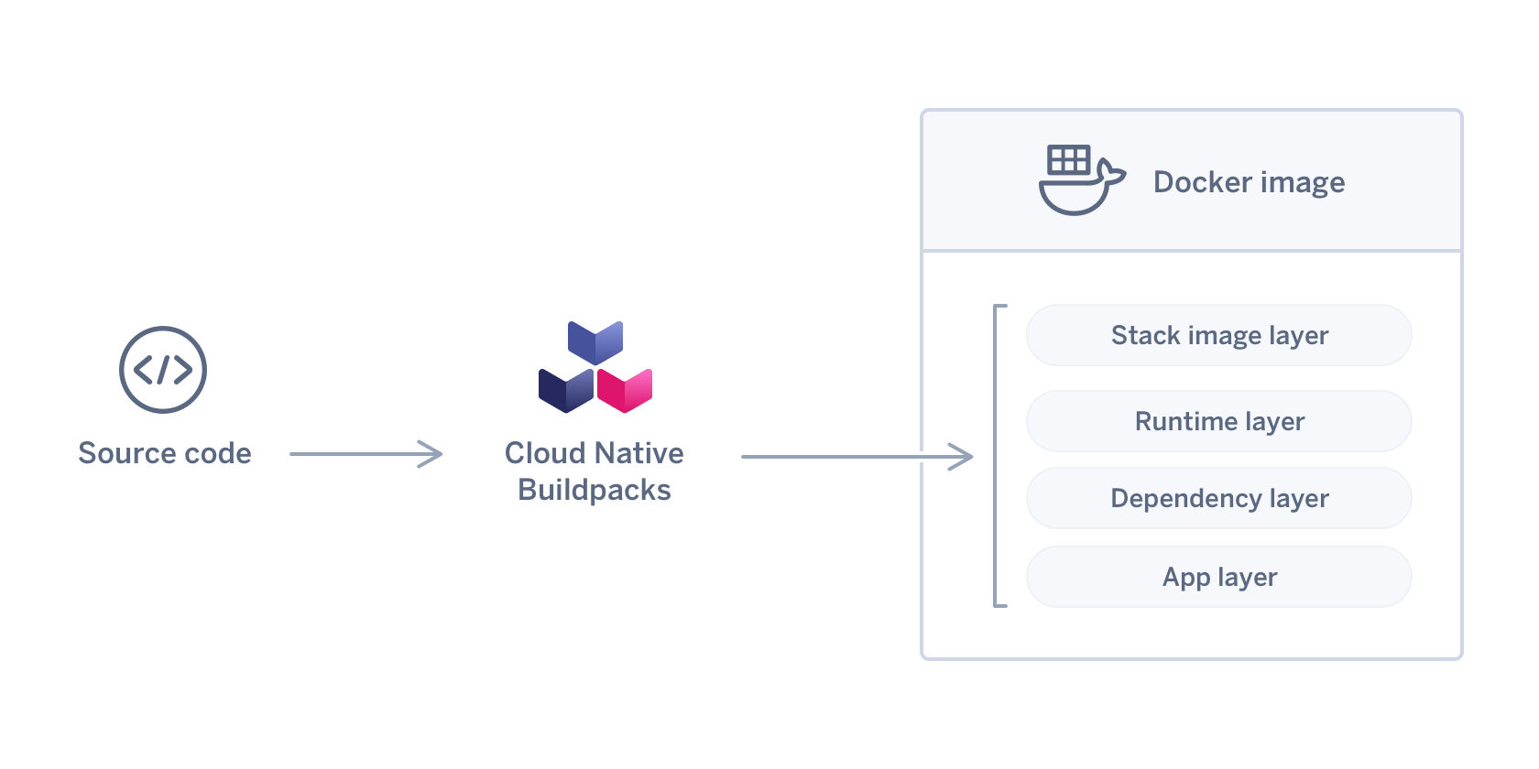
Creating more secure containers
Cloud Native Buildpacks (https://buildpacks.io)

Slide 4
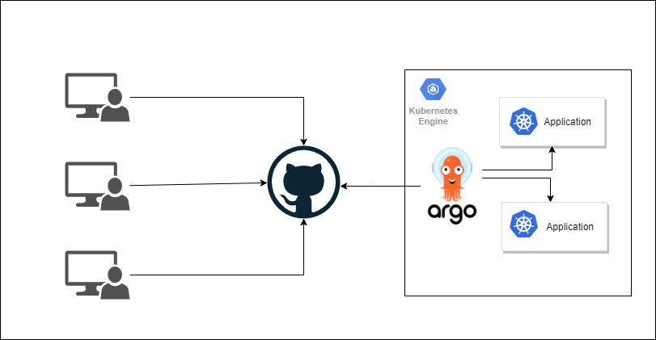
Decoupling CI from CD
ArgoCD (https://argo-cd.readthedocs.io/en/stable/)

Slide 5



Creating a PAAS on top og Kubernetes
Tanzu Application Platform
Get Started
Inner Loop
Outer Loop
Coding & Testing
Dev
Debug
Check-in
Test & Build
Scan, Sign & Store
Deploy & Run
Configure
Merge
Choreograph (Supply Chain + Convention Service)
Sec
Ops
Notes:
Inner Loop – All the tooling developers need to produce code
Get Started
Create ready made, enterprise conformant code and configurations (App Accelerator)
Find available APIs (API Portal)
Coding & Testing
Never leave the IDE to build, run & debug live code on Kubernetes (IDE Tooling)
Debug
View performance data (App Live View)
Outer Loop – Building and delivery code on approved paths to the desired environments
Supply Chains used to configure steps and configuration
Possible steps & tooling (default in parenthesis)
Test & Build(TBS + pipeline service)
Scan, Sign & Store (Security tools)
Configure (Convention Service)
Deploy (Cloud Native Runtimes)

Slide 6
1. Connect
2. Git
3. Docker
4. Kubernetes
5. CI/CD
6. Misc

